Slide 1
COMMUNICATION SKILLS II (ENGL 158) DEPARTMENT OF ENGLISH
WRITING A CV
Types, CV vs. Resume, Structure of CV

Slide 2
THE CURRICULUM VITAE (CV)
The term Curriculum Vitae is a Latin phrase which means, “Course of Life”.
It is a document of personal advertisement for opportunities such as employment, promotion, scholarship and a research grant.

Slide 3
Types of CV
Traditional/Chronological CV:
It outlines an individual’s work and educational history.
It highlights the progress and achievements of one’s career.
The individual’s history must be captured in the reverse order (starting with the current)
Potential employers mostly ask for this type of CV.

Slide 4
Types of CV cont’d
Functional/Skills based CV:
It highlights an individual’s skills and achievements gained in his/her working career.
It is useful for a graduate or apprentice who just completed his/her education/training to show that he/she possesses skills that may be related and relevant to a job.
It is popular especially in cases where one has held numerous roles which are related.

Slide 5
Types of CV cont’d
Technical CV:
It showcases the skills and experiences required for a technical position or a specific profession.
It focuses on a particular skill, and its related skills, peculiar to a technical job.
It highlights the technical training/education, skills and experience of an individual.
It is usually used by individuals in the fields of Information Technology (IT) and Engineering.

Slide 6
General Purpose Vs. Specific Purpose CV
General Purpose CV
As the name implies, it encapsulates every significant details of one’s personality and life’s accomplishments.
It will contain several sections to give a holistic impression of one’s “course of life”.
This can be written by an individual not for specific purposes. However, they can be edited when needed to meet specific purposes.

Slide 7
General Purpose Vs. Specific Purpose CV
Specific Purpose CV
They are written mainly on the demand of an organization or to meet certain standards of an institution or for specific purposes.
For example, an individual applying for a teaching appointment in an institution must specifically tailor his/her CV to highlight areas of interest in teaching.
The individual, in this case, can add the position he/she is applying for on the CV.
It is important to plan the information on the CV to meet the needs for which the document is being prepared.
A thorough background investigation of the authorizer is recommended to know how to tailor the CV.

Slide 8
The CV Vs. Resume
These are two documents of similar profile which presents some sort of information about an individual.
They are however considered as separate documents by some institutions and in some countries (Especially, in the USA).
Usually, a CV gives details of the necessary information such as education and work experience whilst the resume presents a concise account, usually of one’s skills and qualifications.
It is always important to inquire which of the two documents is required in an institution or a country.

Slide 9
The CV Vs. Resume cont’d
Some Similarities
Both CVs & Resumes:
• Are tailored for the specific job/company you are applying to
• Should represent you as the best qualified candidate
• Are used to get you an interview
• Do not usually include personal interests

Slide 10
The CV Vs. Resume cont’d
Some Differences of CV and Resume
A CV is a Latin phrase which means “Course of life” whereas Resume is a French word which means “Summary”
A CV is comprehensive (2-20 pages or more) whereas a resume is concise (1-2 pages).
References/Referees are included in CV whereas they are not in resume.
CV is more oriented to academic credentials whereas resume is to non-academic credentials
Education is mentioned at the top of the CV whereas it is mentioned after experience in resume

Slide 11
Structure of the CV
Generally, CVs may have the following areas:
• Personal Details/Data
• Education
• Experience
• Reference/Referees

Slide 12
Personal Details/Data
The following are important in this section:
• Name (in full)
• Addresses
1. Postal Address
2. Home Address (if necessary)
3. Email Address
4. Website Address (if necessary)
• Date of Birth (if necessary)
• Place of Birth/ Home town (if necessary)
• Nationality (if necessary)
Sex (if necessary)
• Marital Status (if necessary)
NB: it is important to know what the recipient is looking for in the CV.

Slide 13
Personal Details/Data cont’d
The name and other entries can however be omitted under this section when it forms part of the Heading thus;
CURRICULUM VITAE: AMA SARPOMAA SARPONG
Phone: +233659655907/ +233800361650
E-mail: assarpong@yahoo.com
E-mail: assarpong@gmail.com
Personal Data
Date of Birth: 28th October, 1980
Hometown: Asante Bekwai
Marital Status: Married

Slide 14
Education
This section must be written in the reverse chronological order i.e. the most recent educational qualification should be entered first in a ‘descending’ order.
For individuals who have numerous post-secondary school academic qualification, the first and second cycle academic qualification can be omitted.
Dates must always be added to the Schools and Certificates awarded.

Slide 15
Education cont’d
The official names of the institutions or schools must be written and not abbreviations or acronyms.
Again, the specialization or official name of the certificate or degree awarded must be stated.
Eg. Bachelor of Arts (English).
This must be stated as written on the certificate awarded.
The Class Division can be stated for special effect, especially when the individual excels (First Class, Second Class (Upper Division), Distinction, etc.).

Slide 16
Education cont’d
Dissertations or thesis topics can be added to the Schools and Certificates awarded for individuals using the CV for specific purposes in academia or any job that requires research skills.

Slide 17
Work Experience
This summarizes the experiences one has garnered over the years in his/her working life.
It includes internships, attachment, National Service, Substantive job or work etc.
This section must include;
The name of Work Place: For verification purposes, it is important to state the organizational name.
No one would believe your claim of job experience without the veracity of an institutional name.
Job Title: Stating the job title also eases the verification process for prospective employers.

Slide 18
Work Experience cont’d
Job Specification: In cases where one is applying for employment, the job specification of the previous work may be included when the job being applied for is related to it.
This shows the individual’s suitability for the appointment and increases his/her employability

Slide 19
Reference/Referees
This section lists individuals of high reputation/offices to be contacted for any enquires on the individual’s competencies or character.
Prospective employers etc. may contact referees for testimonials.
This section must include the contact information i.e. phone numbers, e-mails etc.
One may however submit referees on request but must be stated in the CV.

Slide 20
Structure of the CV cont’d
Other areas:
The entries espoused above are the general, if not the most important, of the content of the CV.
Other entries may include, based on the purpose of the CV, the following;
1. Personal Statement/ Personal objective/ Personal Profile
2. Professional Skills
3. Professional Development (This includes workshop, symposium, seminar, etc. attended)

Slide 21
Structure of the CV cont’d
Other areas:
4. Publications (research papers, books, etc.)
5. Presentations (at workshops etc.)
6. Memberships and Affiliations
7. Community Service/ Voluntary Work
8. Awards
9. Interest/Hobbies

Slide 22
In-class Activity
Students are to go on the internet and search for samples of CVs and identify the various sections or parts of the CVs they have seen for discussion.
They are to print samples for their keeps, after class, to serve as a guide in preparing their personal CVs

Slide 23
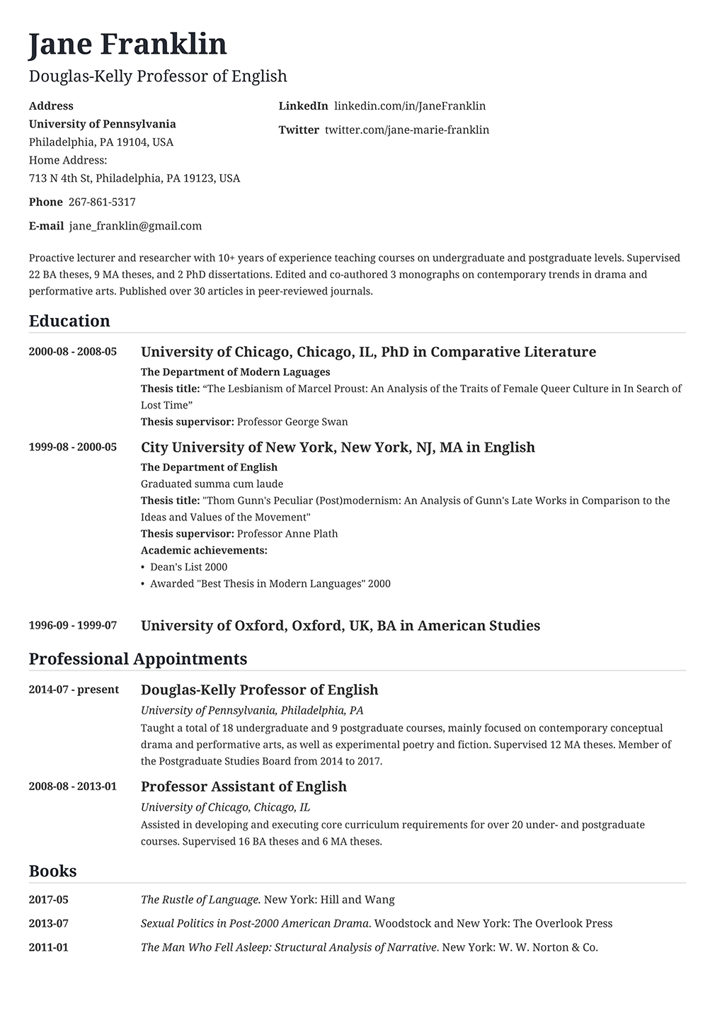

Slide 24
Assignment
You have seen a call for interns at the “Sweet Mother Group of Companies”. Prepare a personal CV to aid your application.

Slide 25
Works Consulted
Adolinama, P. P. (2005). Communication Skills for University Students. Accra: ANEST Company Limited
Brisk, P. H. (2011). Creating your CV as a Self Marketing Tool. Paul H. Brisk & Ventus Publishing ApS.
Curricula Vitae (CVs) versus Resumes. (2011, December 28). Retrieved August 6, 2018, from The Writing Center, University of North Carolina at Chapel Hill: https://writingcenter.unc.edu/tips-and-tools/curricula-vitae-cvs-versus-resumes/
Resume vs. Curriculum Vitae: What's the Difference? (2015, September 14). Retrieved August 6, 2018, from University of California, Davis: Internship and Career Center: https://icc.ucdavis.edu/materials/resume/resumecv.htm
Sekyi-Baidoo, Y. (2003). Learning and Communicating. Accra: Infinity Graphics Limited.

